Slide 1
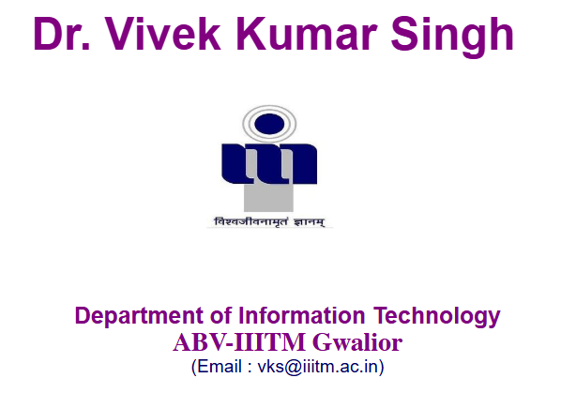
Software Engineering
Module 1: Introduction
From coding software to engineering reliable systems
Notes:
1.#
‹#›
‹#›

Slide 2
Think?
If AI can write code in seconds…
Why do we still need Software Engineers?
What happens when the generated software is wrong, insecure, expensive, or impossible to maintain?

Slide 3
A Simple Real-World Scenario
Build an online examination system for 1,00,000 students.
Features: registration, authentication, exams, evaluation, results, reports and security.
Constraints: 8 months, limited budget, multiple developers, 5-year maintenance.
Question: Is programming knowledge alone enough?

Slide 4
What Can Go Wrong?
Requirements may be incomplete or ambiguous
Architecture may not scale
Different developers may produce incompatible components
Software may contain defects and security vulnerabilities
Project may exceed cost or schedule
Users may change requirements
Production failures may occur
Someone must verify, maintain and evolve the system

Slide 5
Programming vs. Software Engineering
Programming → primarily concerned with implementing solutions
Software Engineering → systematic development, operation and maintenance of software
Programming is one activity within the larger engineering lifecycle
A software product must also be understood, tested, deployed, secured, documented and maintained

Slide 6
Why Software Engineering Emerged
Early software projects became increasingly large and complex
Projects experienced cost overruns, schedule delays and poor quality
Requirements changed while development was underway
Maintenance became a major part of software cost
Engineering discipline was needed to manage complexity and quality

Slide 7
The Software Engineering View
What should we build? → Requirements
How should we build it? → Design & Architecture
How do we build it systematically? → Process
How do we know it works? → Verification & Testing
Is it good enough? → Quality & Metrics
How do we evolve it? → Maintenance & Evolution

Slide 8
The Traditional Software Lifecycle
Problem → Requirements → Design → Implementation → Testing → Deployment → Maintenance
Different process models organize these activities differently
Waterfall,
V-Model,
Incremental,
Prototyping,
Spiral
Agile provide different approaches

Slide 9
The AI-Assisted Lifecycle
Problem & Requirements
↓
Architecture & Design
↓
AI-assisted coding, testing and documentation
↓
Human review + verification + security
↓
Deployment + monitoring + maintenance
AI accelerates activities; engineering provides control and accountability

Slide 10
What AI Does Well
Generate code and boilerplate
Explain unfamiliar code
Generate test cases and test data
Suggest refactoring
Assist debugging
Generate documentation
Help explore design alternatives
Automate repetitive development tasks

Slide 11
What AI Does NOT Guarantee
Correct requirements
Correct architecture
Correct business logic
Security
Scalability
Reliability
Maintainability
Regulatory or organizational compliance
AI output must be reviewed and validated

Slide 12
Generated Code ≠ Correct Software
AI can produce code that compiles but implements the wrong requirement
It can miss edge cases
It can introduce vulnerabilities or unsafe assumptions
It can use outdated or unsuitable approaches
Therefore: Generate → Review → Test → Verify → Monitor

Slide 13
A Key Shift in the Engineer’s Role
Before: significant effort spent manually writing code
Now: more leverage from AI-assisted implementation
Increased importance of requirements, architecture, verification, security, quality and system-level thinking
Future engineer: orchestrates people, tools and AI to deliver reliable software

Slide 14
Software Engineering + AI
Requirements → AI can refine and summarize; engineer validates
Design → AI can suggest alternatives; engineer selects
Coding → AI can generate; engineer reviews
Testing → AI can generate tests; engineer defines coverage and acceptance
Maintenance → AI can understand legacy code; engineer controls changes

Slide 15
Course Roadmap
Foundations, SDLC & Process Models
Requirements Engineering
Project Planning, Estimation, Scheduling & Risk
Design, Architecture, UML & Design Patterns
Implementation, Testing & Debugging
Quality, Maintenance, DevOps & Integrated Case Study

Slide 16
Module 1: Foundations & Process
Software characteristics
Software process and SDLC
Waterfall and V-Model
Incremental, Prototyping, Spiral and RAD
Process-model selection

Slide 17
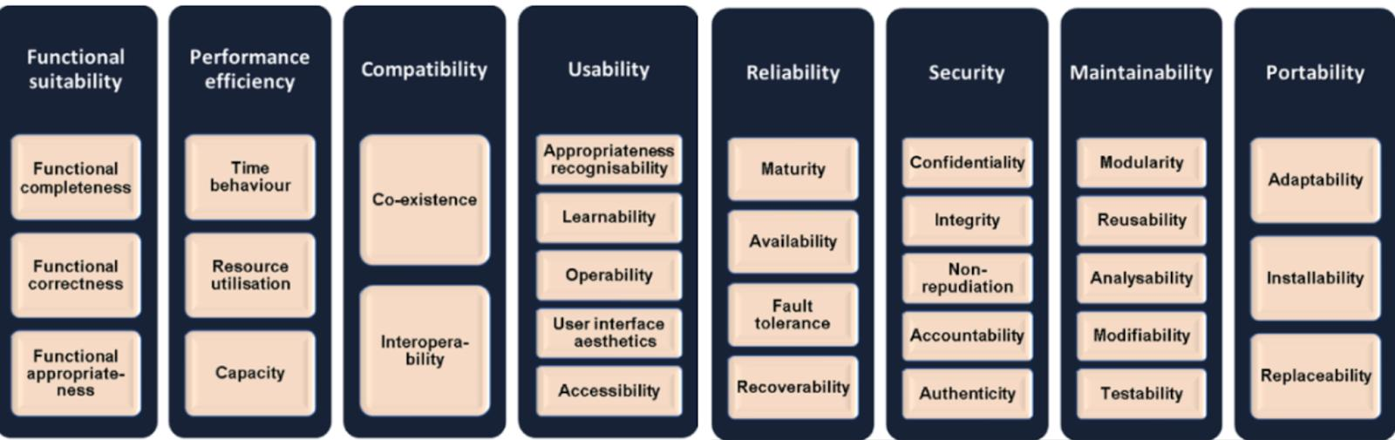
Module 1: Software characteristics
Software is developed/engineered not manufactured in classic sense
Software doesn’t wear out but deteriorate
Software can also be developed component wise and integrated

Slide 18
Module 1: Software Applications
System Software
Real-time Software
Embedded Software
Business application Software
Engineering and Scientific Software
Personal Software
Web Software

Slide 19
Software Engineering
To develop the efficient quality software in the different application domain to satisfy the various high-level objectives, there is a need of this systematic approach, which is known as the software engineering.

Slide 20
Module 1: Process
A software process means the systematic set of activities used to develop, deliver, and maintain software.
A software process is a structured way of answering:
  What do we do, in what order, and how do we do it to build good software?
Identify Problem
↓
Gather Requirements
↓
Analyze Requirements
↓
Design the System
↓
Implement / Code
↓
Test
↓
Deploy
↓
Maintain & Improve
This sequence of activities constitutes a software process.

Slide 21
Process ≠ Process Model
Software Process = What activities are involved in software development?
          For example:
              Requirements
              Design
              Implementation
              Testing
              Deployment
              Maintenance
Process Model = How are these activities organized and carried out?
          For example:
          Waterfall → activities largely performed sequentially
          Incremental → software developed in increments
          Spiral → development organized around iterative risk analysis
          Agile → short iterations/sprints with continuous feedback

Slide 22
Need a software process
“If ten developers are asked to build a large software system, should everyone simply start coding?”
If not
software process → SDLC → process models.
Without a defined process, a software project can become often leads to:
    unclear requirements
    rework
    poor coordination
    missed deadlines
    cost overruns
    defects
    difficult maintenance
A good software process provides discipline, coordination, visibility, quality control, and repeatability.

Slide 23
Software Defined Life Cycle (SDLC)
SDLC describes the major activities involved in taking software from an initial idea or requirement to a working system and its maintenance.
Phase | Main question | Typical activities
1. Requirements | What does the customer need? | Requirement gathering, SRS
2. Planning | How will we develop it? | Cost, schedule, resources, risks
3. Analysis | What exactly should the system do? | System analysis, feasibility
4. Design | How will we build it? | Architecture, database, UI, components
5. Implementation | How do we construct it? | Programming, integration
6. Testing | Does it work correctly? | Unit, integration, system, acceptance testing
7. Deployment | How do we deliver it? | Installation, release, configuration
8. Maintenance | How do we keep it useful? | Bug fixes, updates, enhancements
Requirements
↓
Planning
↓
System Analysis
↓
Design
↓
Implementation / Coding
↓
Testing
↓
Deployment
↓
Maintenance
↺

Slide 24
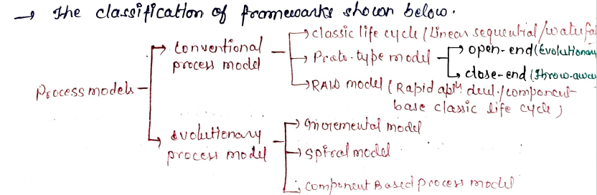
Software Process Model
SDLC is not itself a development model.
This distinction is important:
SDLC → describes the activities/phases involved in software development.
Software process model → describes how those activities are organized and performed.
For more details, refer the PDF document provided in GCR.

